Slide 1
Machine Learning: a hands-on experience
Session 1
Gabriele Bonomi Boseggia, Fabio Colombo, Luca Mammi
Milan, May 24th, 2018

Slide 2
Welcome and thanks for being here!
While we start talking, let's get the systems up and running:
If you followed the instructions and want to run Jupyter Notebooks locally, please download the zip at this link
OR
If you want to follow the lessons online please follow this link
https://github.com/gbonomib/mlTeachings/archive/master.zip
http://beta.mybinder.org/v2/gh/gbonomib/mlTeachings/master?filepath=1_1_intro_tidyverse.ipynb?urlpath=tree

Slide 3
AGENDA
Session 1: Introduction to Machine Learning
an introduction to Machine Learning
an introduction to the necessary R tools
some Machine Learning algorithms and models
…with code – hands on!
Session 2: Model Selection and Validation
more Machine Learning models
Model Selection and Validation
Model Training Strategies and Hyperparameter Tuning
…with code – hands on!
Session 3: Neural Networks
an introduction to Neural Networks (w/ code, hands on!)
some Deep Learning examples
…with code – hands on!

Slide 4





Why do we need Machine Learning?
Every decisional process we observe is the outcome of a judgmental process
Sometimes it is useful to automatize such processes, to support human decision
Take an umbrella while leaving for work
Ok, maybe not!
€
Grant a loan to someone
Grant loans to 1 million candidates
Apply a commercial offer to a client
Associate similar offers to similar clients
Extract the main message of written text
Identify spam
Identify contents of a picture
Identify diseases in a million CAT scans

Slide 5
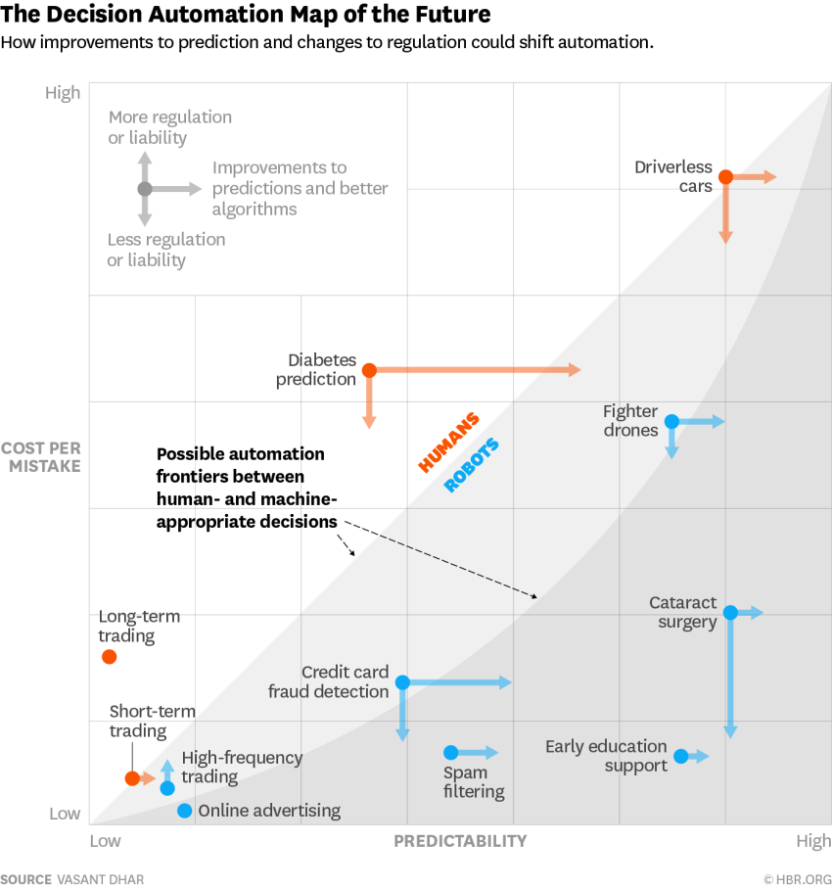
What is Machine Learning used for?
https://hbr.org/2016/05/when-to-trust-robots-with-decisions-and-when-not-to

Slide 6
What is Machine Learning?
Machine Learning is a set of tools that use information to enable the automation of decision making
Training Data
Machine Learning Algorithm
New Data
Trained Model
Prediction
Prescriptive Analytics
Machine learning
Decision making

Slide 7
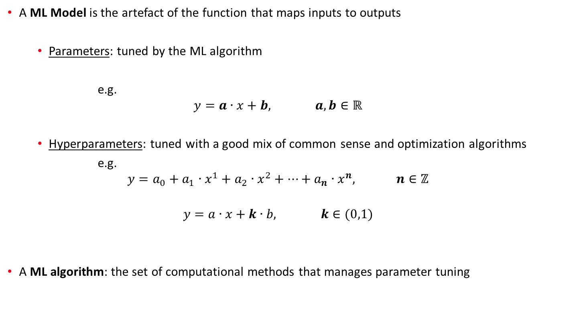
What is Machine Learning?
A ML Model is the artefact of the function that maps inputs to outputs
Parameters: tuned by the ML algorithm
e.g.
$$y=a∙x+b, a,b∈ℝ$$
Hyperparameters: tuned with a good mix of common sense and optimization algorithms
e.g.
$$y=a_{0}+a_{1}∙x^{1}+a_{2}∙x^{2}+…+a_{n}∙x^{n}, n∈ℤ$$
$$y=a∙x+k∙b, k∈(0,1)$$
A ML algorithm: the set of computational methods that manages parameter tuning

Slide 8
Types of Machine Learning – by how they work
Labelled data
Unlabelled data
Environment model
Supervised learning
Unsupervised learning
Reinforcement learning
Classification
Clustering
Regression
Dimensionality reduction
…but is this the most
effective taxonomy?

Slide 9
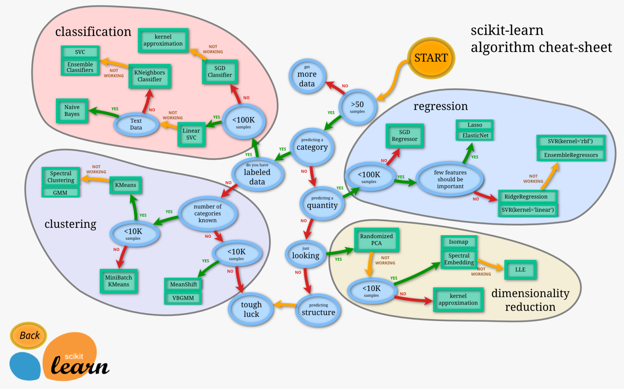
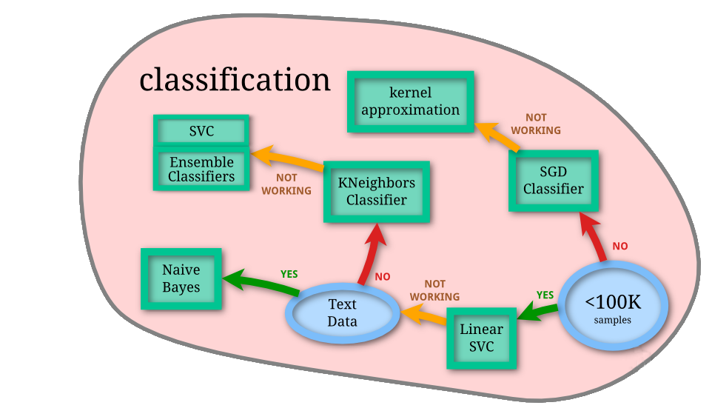
Types of Machine Learning – by what we need them to do
we will focus on examples of classification
http://scikit-learn.org/stable/tutorial/machine_learning_map/index.html

Slide 10
Machine Learning is nothing new, why the hype?
A.M. Legendre: least squares method
Google Brain: NN to recognize cats in videos
IBM: programs that play checkers
Facebook: DeepFace to recognize faces
F. Rosenblatt: the perceptron
Google: Sibyl to predict user behavior
T. Cover, P. Hart: k-NN
Google: AlphaGo beats humans at Go
S. Linnainmaa: automatic differentiation
Stanford University: a cart that can navigate and avoid obstacles in a room
K. Fukushima - the neocognitron
D. Rumelhart, G. Hinton, R.J. Williams: backpropagation
C. Watkins - Q-learning for reinforcement learning
G. Tesauro: machine playing backgammon
T.K. Ho: random decision forests
C. Cortes, V. Vapnik: SVM
S. Hochreiter, J. Schmidhuber: LSTM for recurrent NNs
IBM: machine beats chess world champion Kasparov
Netflix Prize competition launched (won in 2009)
IBM: programs that play checkers
Kaggle is born
G. Hinton: capsule networks
1805
1952
1957
1967
1970
1979
1980
1986
1989
1992
1995
1997
2006
2010
2011
2012
2014
2016
2017
https://en.wikipedia.org/wiki/Timeline_of_machine_learning

Slide 11



What do you need for Machine Learning?
You just need the right R packages!
tidyverse (developed by Hadley Wickham, Chief Scientist at Rstudio)
"a set of packages that work in harmony because they share common data representations and API design"
including dplyr, ggplot2, tidyr
caret (Classification And REgression Training)
"a set of functions that attempt to streamline the process for creating predictive models"
calls packages such as e1071, keras, mlbench, randomForest
Hands on the code!
1_1_intro_tidyverse.ipynb
Hands on the code!
1_2_mlpackages.ipynb
https://cran.r-project.org/package=tidyverse, Wickham, Hadley (2017). "R for data science"
https://cran.r-project.org/package=caret

Slide 12
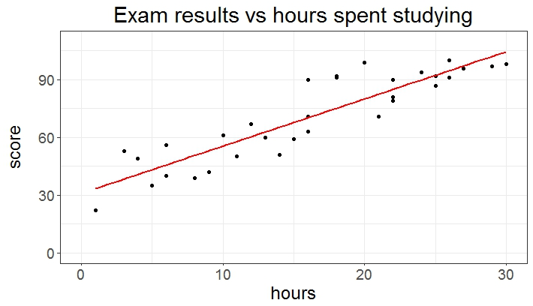
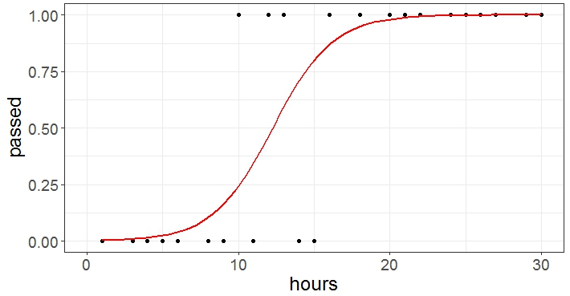
Machine Learning models: linear and logistic regressions
You might already know…
Linear Regression
to predict a score
Logistic Regression
to predict a probability

Slide 13
Machine Learning models: k-Nearest Neighbors (k-NN)
A conceptually simple algorithm: if you want to classify a new item, look at its neighbors!
How many neighbors?
Obviously K!
Which neighbors are the nearest ones?
Euclidean distance
Chebyshev distance
Manhattan distance
and many more…
What if the k nearest neighbors belong to different classes?
Tyranny of the majority
Weighted by distance: kernel & links with non parametric models
k=3
Hands on the code!
1_3_knn.ipynb

Slide 14
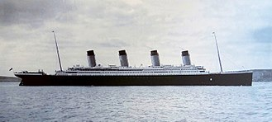
Let's give this all a try
…using the famous Titanic dataset!
Imagine having the data from the passengers on the disastrous ship, could you predict who survived?
survived | pclass | sex | age | sibsp | parch | fare | cabin | embarked
1 | 1 | female | 29.0000 | 0 | 0 | 211.3375 | B5 | S
1 | 1 | male | 0.9167 | 1 | 2 | 151.5500 | C22 C26 | S
0 | 1 | female | 2.0000 | 1 | 2 | 151.5500 | C22 C26 | S
0 | 1 | male | 30.0000 | 1 | 2 | 151.5500 | C22 C26 | S
0 | 1 | female | 25.0000 | 1 | 2 | 151.5500 | C22 C26 | S
… | … | … | … | … | … | … | … | …
Hands on the code!
1_6_titanic.ipynb

